Slide 1
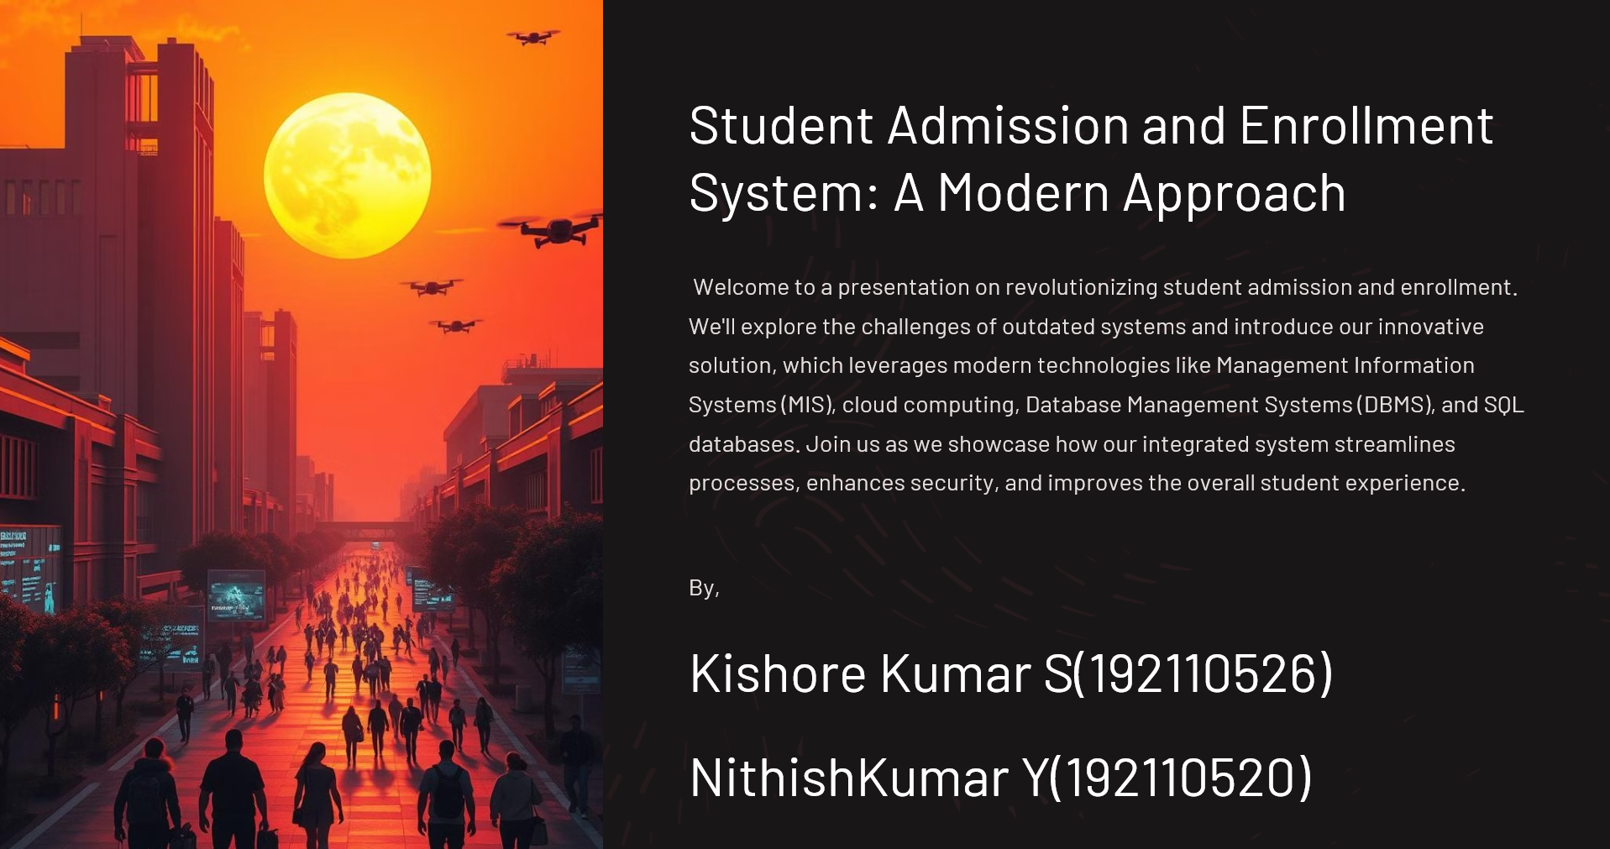

Slide 2
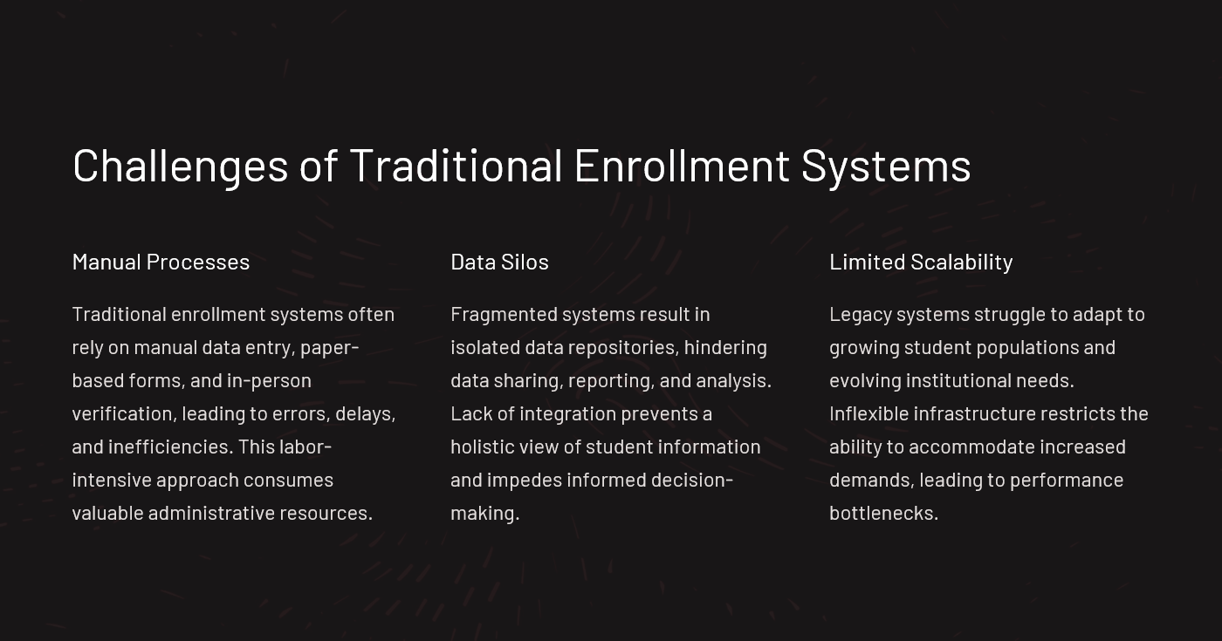

Slide 3
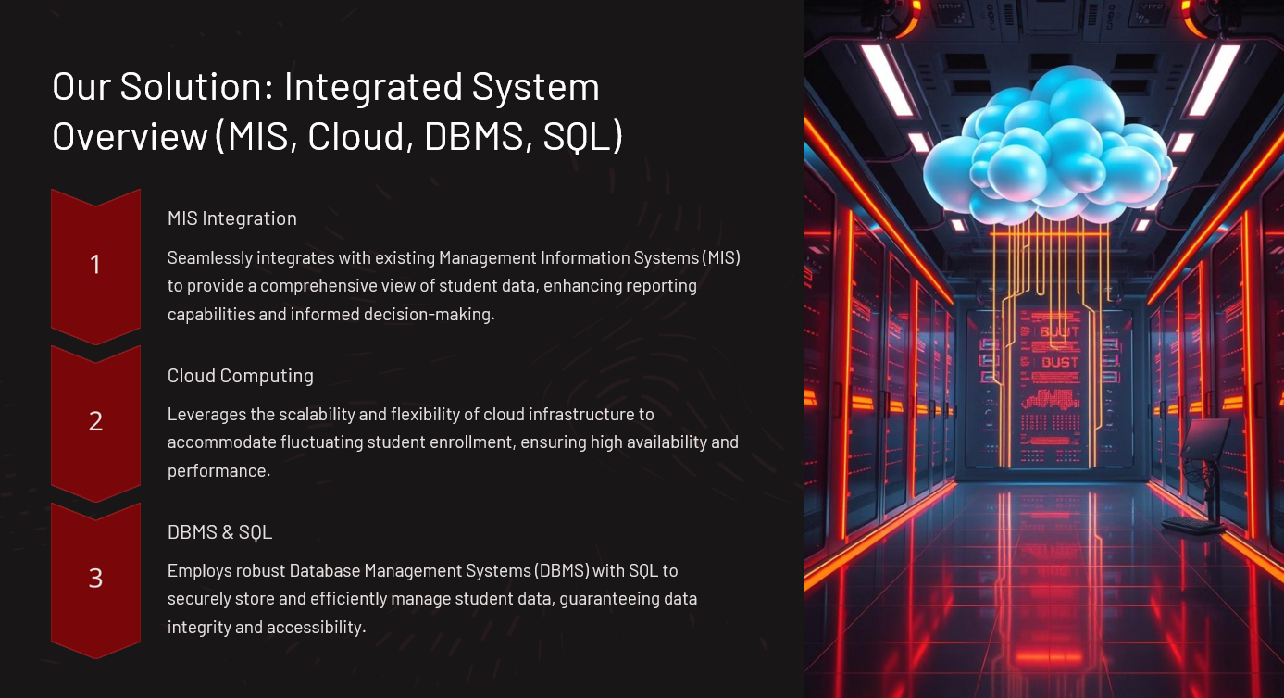

Slide 4

Software Implementation
This presentation outlines a modern, efficient system for student admission and enrollment, leveraging Management Information Systems (MIS), cloud computing, Database Management Systems (DBMS), SQL, SOA implementation, and robust hardware infrastructure. The goal is to create a user-friendly, scalable, and secure platform that streamlines the entire process, from initial application to final enrollment.
We will explore the key software components, database structure, and cloud-based architecture, focusing on how these elements work together to enhance data management, improve accessibility, and automate administrative tasks. Furthermore, we will delve into the critical hardware considerations necessary to support the system's performance and reliability.

Slide 5
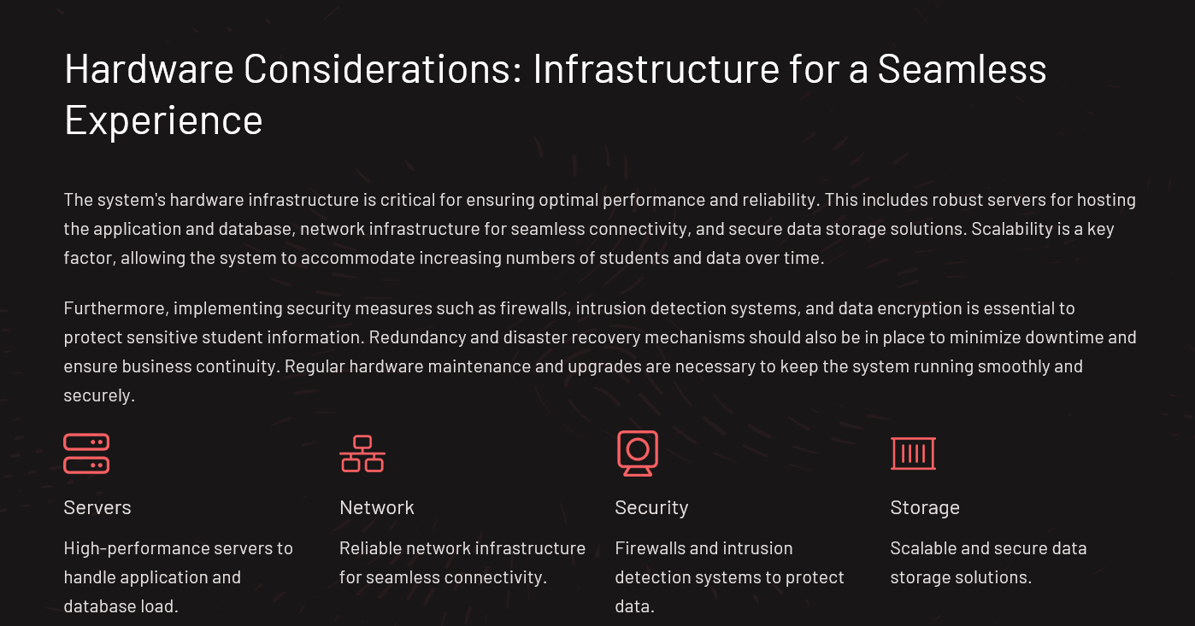

Slide 6
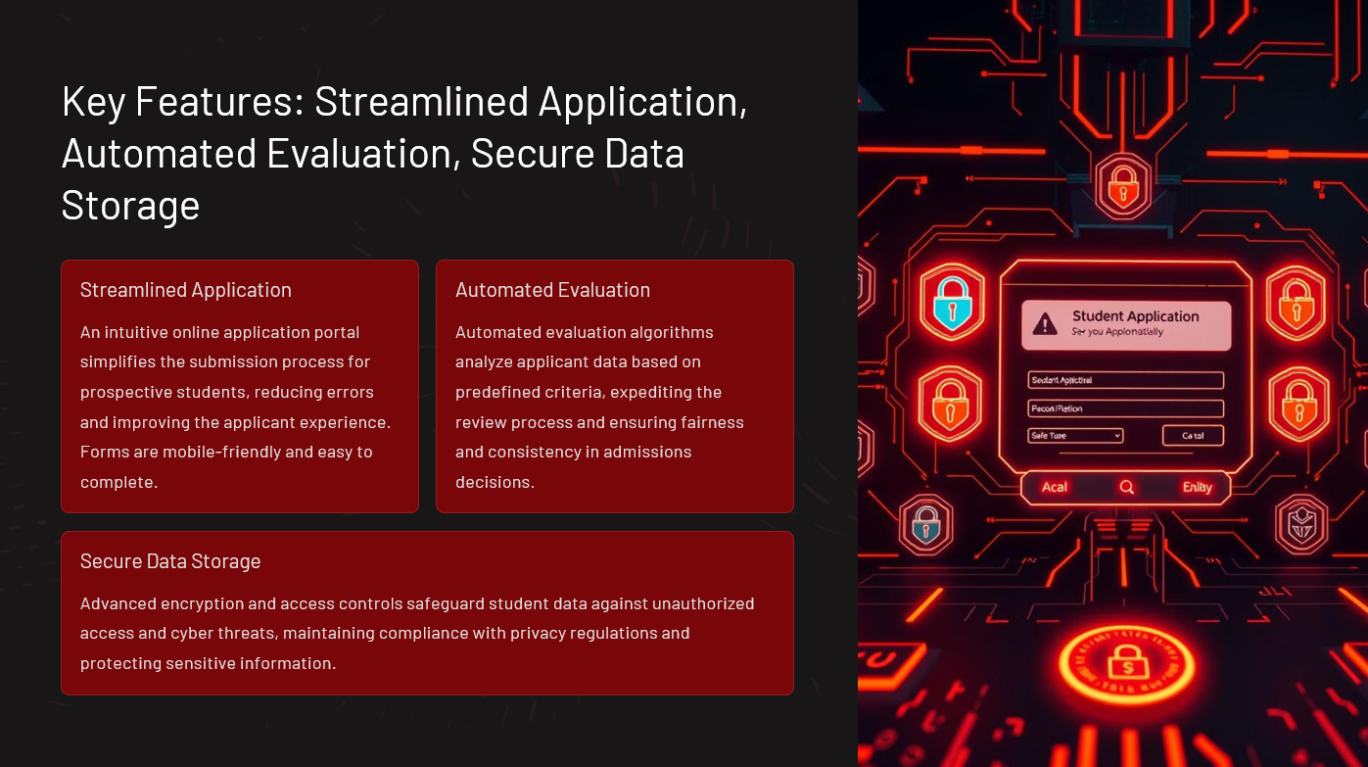

Slide 7
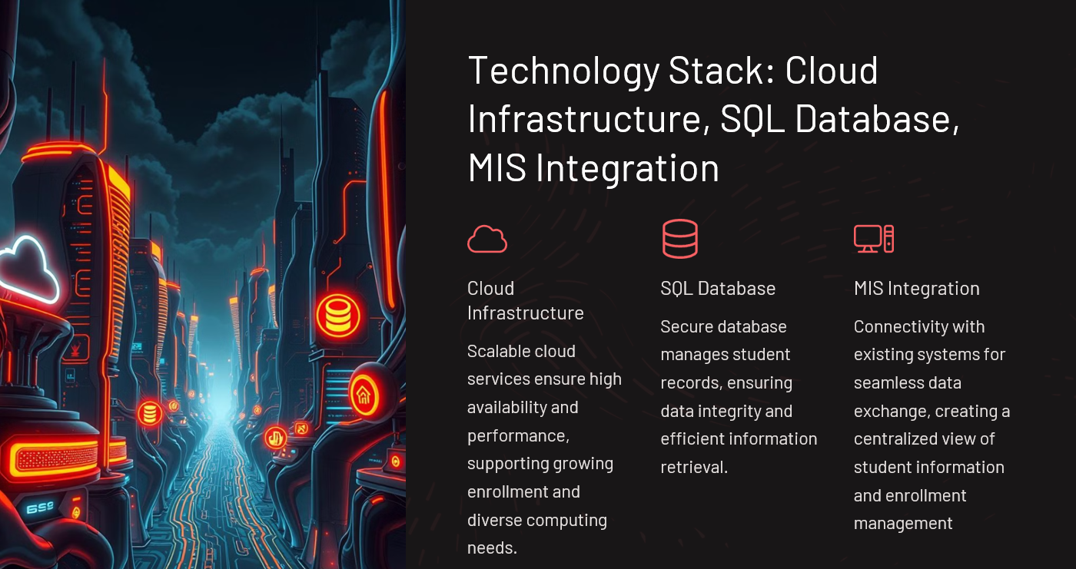

Slide 8
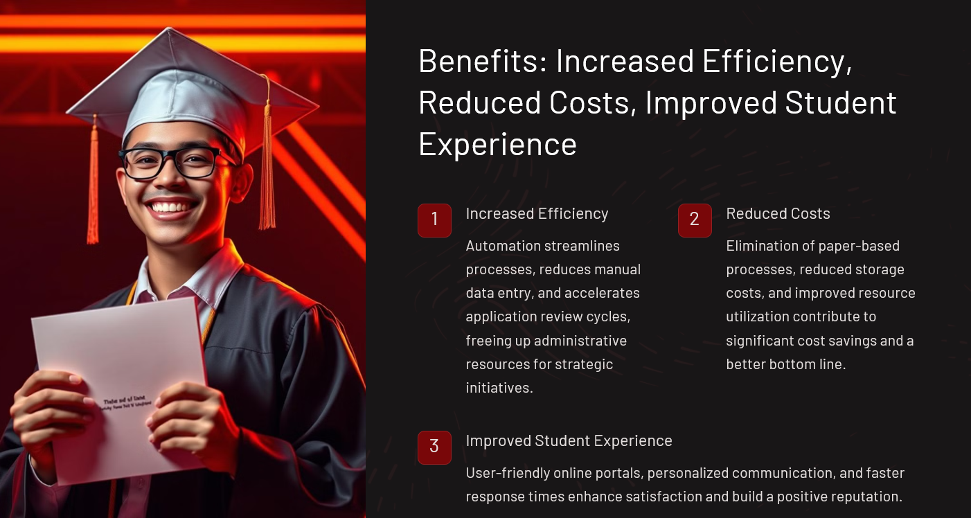

Slide 9
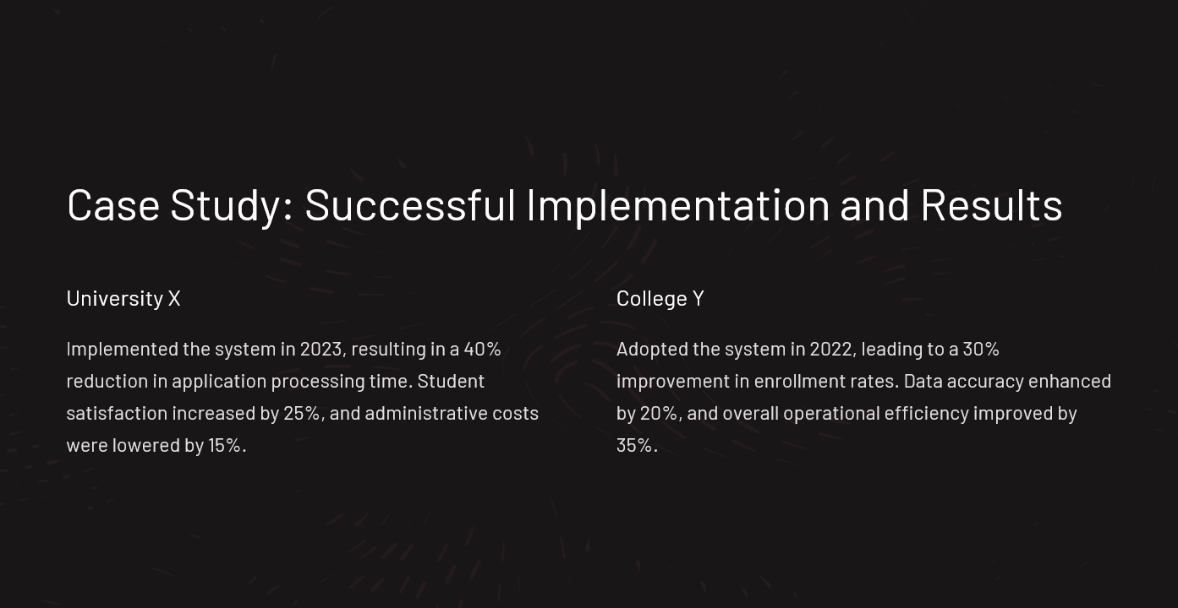

Slide 10
